Slide 1
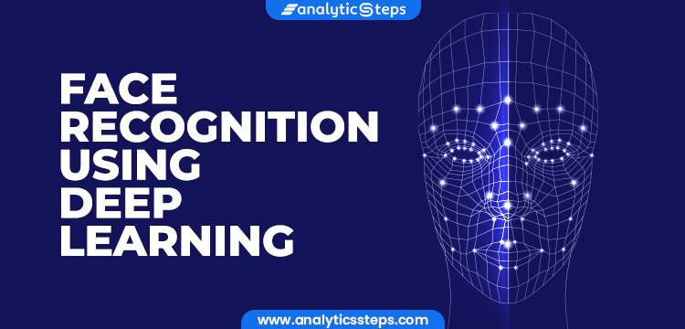

By
…………………………

Slide 2

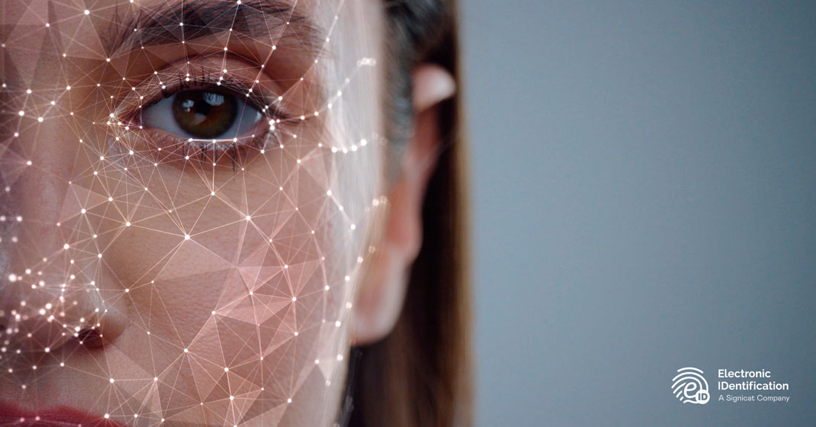
face recognition:
Facial recognition is a way of identifying or confirming an individual’s identity using their face. Facial recognition systems can be used to identify people in photos, videos, or in real-time.

Slide 3
Face Recognition Models:
Face Recognition using Deep learning
VGG-Face
FaceNet
DeepFace
DeepID
VGG-Face
FaceNet
DeepFace
DeepID
Google
Oxford
Facebook
OpenCV
Notes:
VGGNet: Visual Geometry Group designed by Oxford Researchers. The model has attained the accuracy of 97.2% on the LFW dataset.
DeepFace: designed by Facebook researchers , model has achieved an accuracy of 97.35 of the LFW dataset.
FaceNet was designed by Google researchers , model has reached an accuracy of 99.60% of the LFW dataset.
DeepID: OpenCV model had an accuracy of 98% for LFW dataset. LFW stands for labeled faced in the wild home

Slide 4
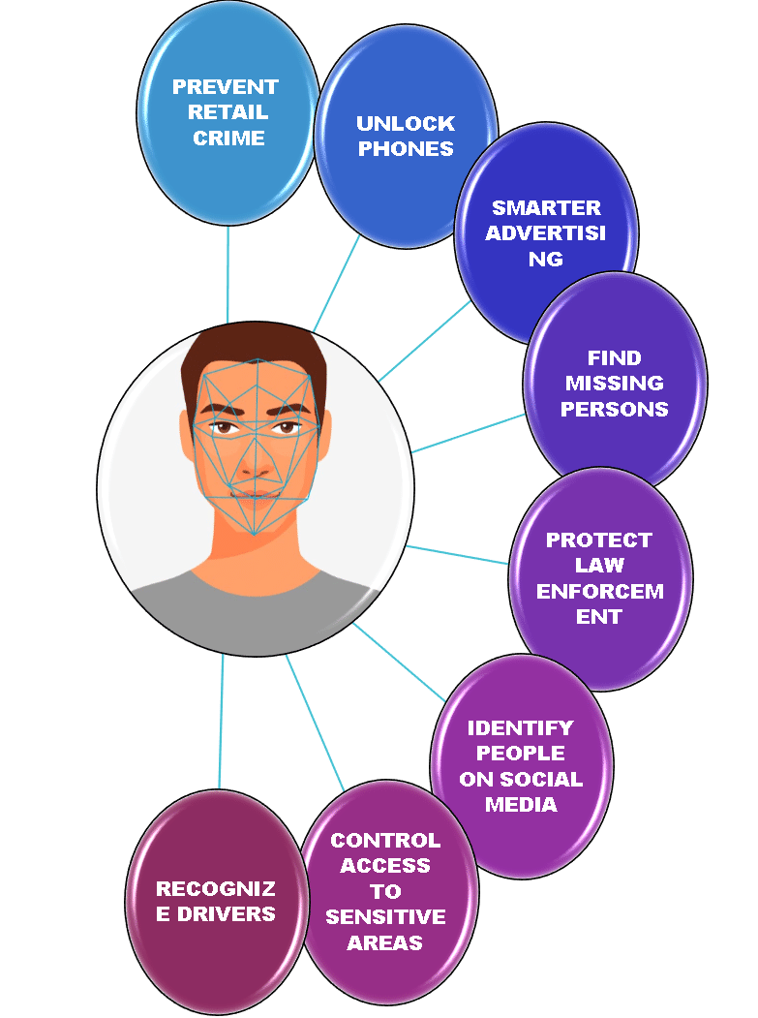
Applications Of Facial Recognition System:
Facial Recognition System can be used for:
Video Surveillance
Identify people over Internet
Mobile security
Airports
Healthcare
Fraud detection
Payments
Advertising
Notes:
Facial recognition system can be applied in different domain of our daily life:
Video surveillance using face recognition systems is a technology that uses artificial intelligence (AI) and computer vision to identify and track individuals based on their facial features.
Patient identification: Access control: Patient monitoring are the applications of facial recognition system in healthcare.

Slide 5
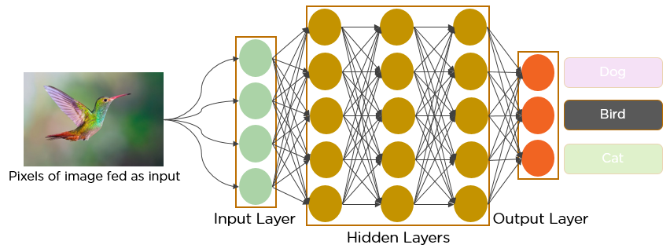
CNN-based face recognition system
Convolution Neural network (CNN):
convolutional neural network (CNN/ConvNet) is a class of deep neural networks, most commonly applied to analyze visual imagery. A Simple CNN With One Input, 3 Hidden And 1 Output Layer For Image Recognition.

Slide 6
Applications of CNN for face recognition system (Research):
Chen et al. [1] proposed a lightweight, CNN-based, real-time face recognition system for low computational devices using low level feature extraction.
Said et al. [2] presented a. face recognition system applying a CNN network. three stages: face detection, feature extraction and classification. achieved an accuracy of 89.99% while tested on the LFW dataset having 13000 face images of different individuals.
Hernandez et al. [3] proposed a quality assessment system called Faceqnet using deep learning models. The model was tested on LFW and YTF datasets and the model was able to gain an accuracy of 92.24% and 91.54%.
Limitations of CNN algorithms for face recognition system:
Input Data: CNN models required large amount of labeled input images data.
CNN models are sensitive to input data, post expression, and light can effects the algorithm performance.
Bias: CNNs can also exhibit biases based on factors such as gender, race, or ethnicity, which can lead to inaccuracies in face recognition and potential discrimination.

Slide 7
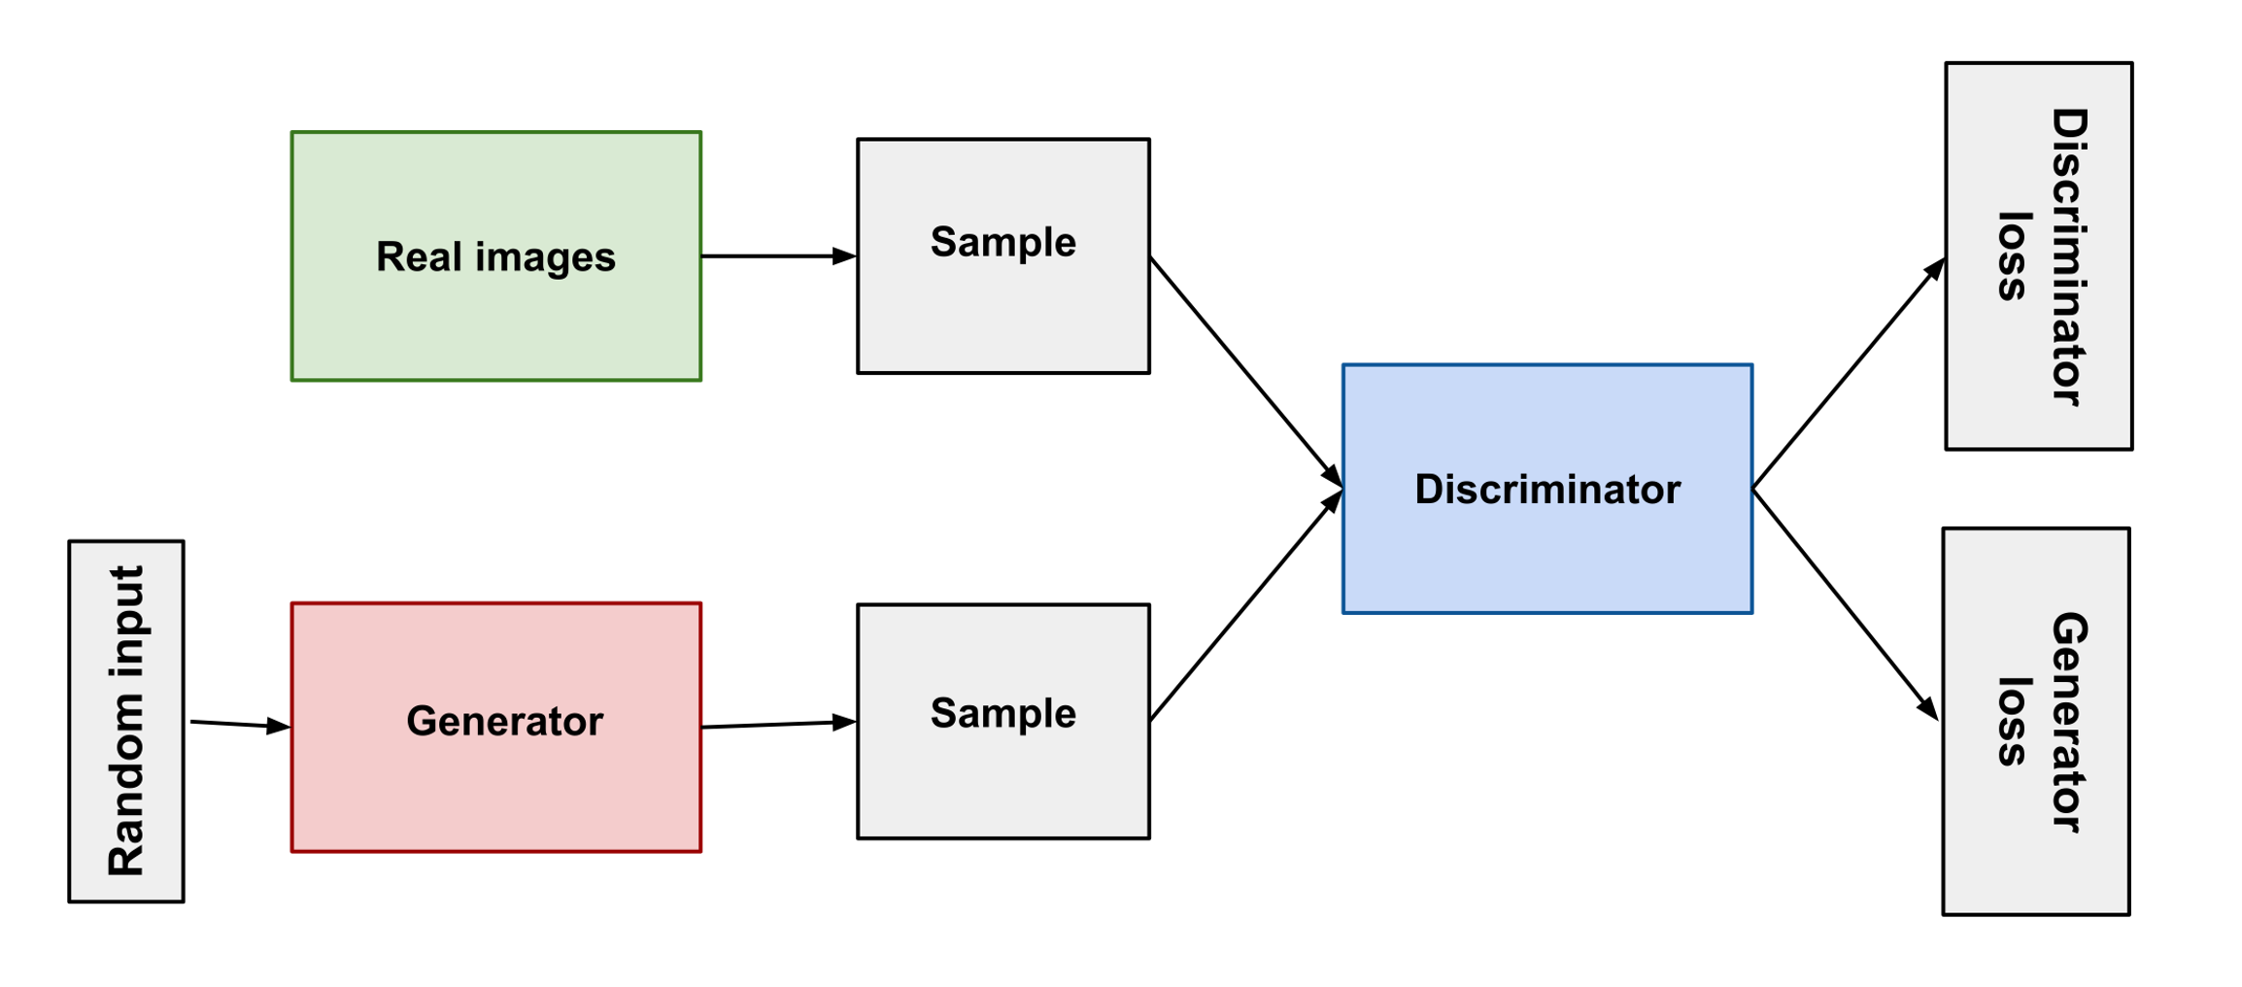
GAN –based Face recognition system:
A generative adversarial network (GAN) is a deep learning model in which two neural networks compete with each other by using deep learning methods to become more accurate in their predictions.

Slide 8
Applications of GAN network for face recognition system:
Luo et al. [4] presented a GAN-based model for generating deformation invariant face images for the accuracy improvement of the recognition system. The FA-GAN model generated a sequence of face images along various deformation, illumination, and rotation conditions for augmentation along the original dataset. it has achieved an accuracy of 99.1% for LFW and 98.3% for the YTF dataset.
Zhang et al. [5] proposed a GAN-based face recognition system for thermal to visible images to solve the problem of thermal visible face images. The TV-GAN model was applied to LFW, YTF, and CASIA- webFace datasets, has gained accuracy of 92.6%, 89.6% and 98.2%.
Limitations of GAN-Based face recognition System:
Limited training data.
Vulnerability to adversarial attacks.
Computationally expensive.
Notes:
Limited training data: GANs require a large amount of training data to learn the underlying distribution of facial features. However, obtaining a large dataset of facial images can be challenging in some cases, particularly when dealing with diverse populations or rare facial conditions.
Vulnerability to adversarial attacks: GANs can be susceptible to adversarial attacks, where small changes to the input image can cause the network to produce inaccurate results. This can lead to security issues in face recognition systems.
Computationally expensive: GANs require significant computational resources for training and inference, which can make them expensive to implement and maintain in some cases.

Slide 9
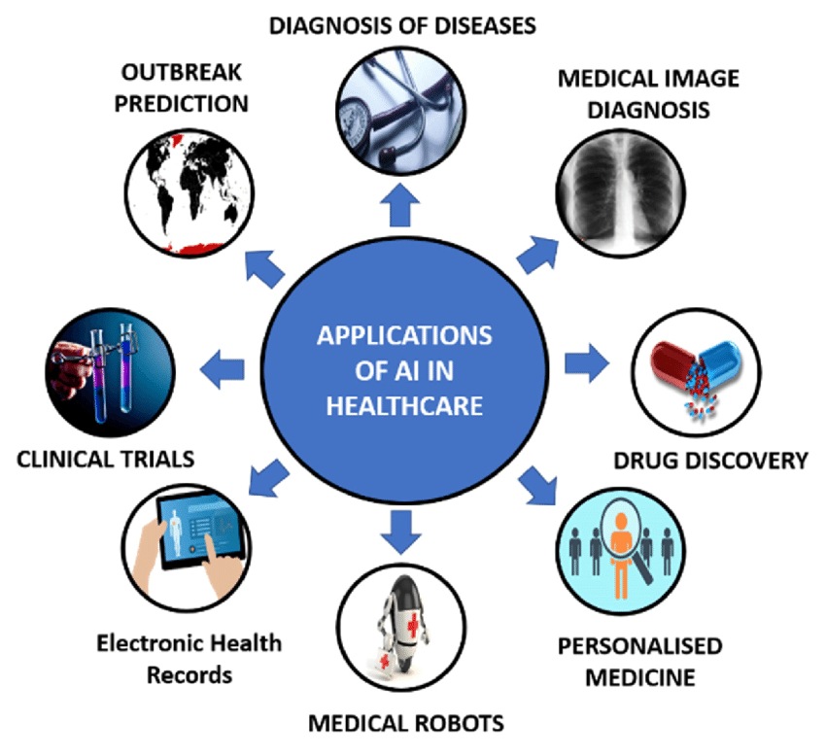

Industrial Applications of Deep learning:
Virtual Assistants: Speech recognition, Natural language Processing, Sentiment Analysis, Image and Object Recognition Fake News Detection: Social media analysis, Fake image and video detection, NLP and sentiment analysis | Healthcare:

Slide 10
Conclusion:
In this paper we presented an applications of deep learning models For face recognition system covering the following topics:
facial recognition system.
applications of Face recognition system
Famous face recognition models
CNN based face recognition system
GAN based recognition system
Applications of deep learning in our lives conclude our presentation

